Slide 1

Employee Management System: A Full Stack Development Project
This presentation outlines the development of a comprehensive employee management system, from concept to deployment.
We'll explore the project's objectives, architecture, technologies,
and key features.

Slide 2

Team Members
Leader: Arijit Dutta (22/ECE/054)
Members:
Arijit Dutta (22/ECE/054) Arighna Jha(22/ECE/053) Brijit Maity(22/CSE-CS/025) Sneha Chourasia(22/ECE/169) Sneha Singh(22/ECE/170) Soham Chowdhury(22/ECE/172)

Slide 3
Introduction: Project Overview and Objectives
1. Project Overview
The Employee Management System (EMS) is a full-stack web application designed to streamline employee data management.
It allows HR and management teams to efficiently handle employee records, attendance, payroll, and performance tracking.
Built using modern web technologies for seamless functionality and scalability.
Focuses on automation, security, and user-friendly interface for enhanced employee data handling.
2. Key Features
✅ Employee Profile Management – Store and manage employee details, roles, and departments. ✅ Category Wise Tracking – Monitor categories and take input. ✅ Secure Role-Based Access – Restrict functionalities based on user roles (Admin, HR, Employee).
3. Project Objectives
🔹 Efficient Data Management: Reduce paperwork and manual record-keeping. 🔹 User-Friendly Interface: Ensure ease of use for HR and employees. 🔹 Security & Access Control: Implement role-based authentication for data protection. 🔹 Scalability: Design a system that can expand as the organization grows.

Slide 4
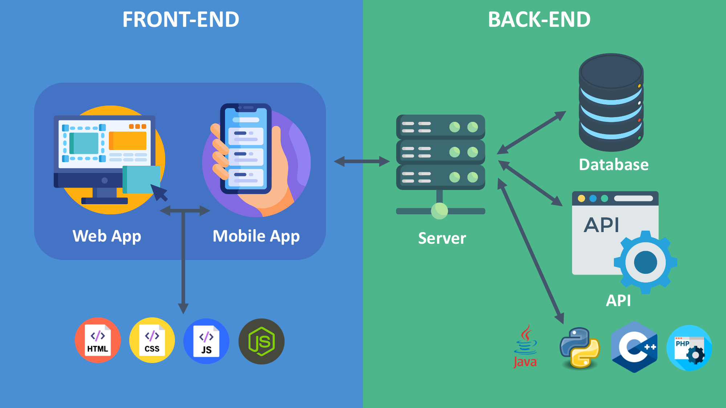
System Architecture: Frontend, Backend and Database
Overview of System Architecture
The Employee Management System follows a Full-Stack architecture comprising:
Front-end (Client-side)
Back-end (Server-side)
Database (Storage & Retrieval)
Front-end (Client-side)
Built using React.js as the primary library for building dynamic UI components.
React Router DOM - is used for seamless navigation and page routing.
Axios- handles API calls efficiently for fetching and sending data.
Bootstrap & Bootstrap Icons are used for responsive UI design and enhanced styling.
Tech Stack:
React.js – UI component-based framework.
React Router DOM – Navigation and routing.
Axios – API integration for communication with the backend.
Bootstrap & Icons – Styling and UI components.
1
2
.
3
Back-end (Server-side)
Not explicitly mentioned in the package.json file, but typically:
Node.js & Express.js can be used for handling API requests and business logic.
RESTful APIs will connect the front-end with the database.
Authentication & Authorization (JWT or OAuth) for user access control.
Tech Stack:
Node.js + Express.js – Server-side logic.
REST APIs – API endpoints for CRUD operations.
Authentication – Role-based access for admin, HR, and employees

Slide 5
4
Database
The package.json does not specify a database, but commonly used databases for an Employee Management System include:
SQL-based (MySQL, PostgreSQL) – Structured and relational data management.
NoSQL-based (MongoDB, Firebase) – Flexible and scalable document-based storage.
Possible Database Choices can be:
MongoDB – NoSQL, flexible schema.
MySQL/PostgreSQL – Structured, relational database with better query performance.
Firebase – Real-time database for live updates.
.
5
System Architecture Flow
🟢 Front-end (React.js) ➡️ Calls API via Axios 🔵 Back-end (Node.js + Express.js) ➡️ Processes requests & interacts with DB 🟠 Database (SQL/NoSQL) ➡️ Stores & retrieves employee data
This architecture ensures:
Modular development for scalability.
Seamless communication between UI, server, and database.
Secure data handling through authentication & access control.

Slide 6
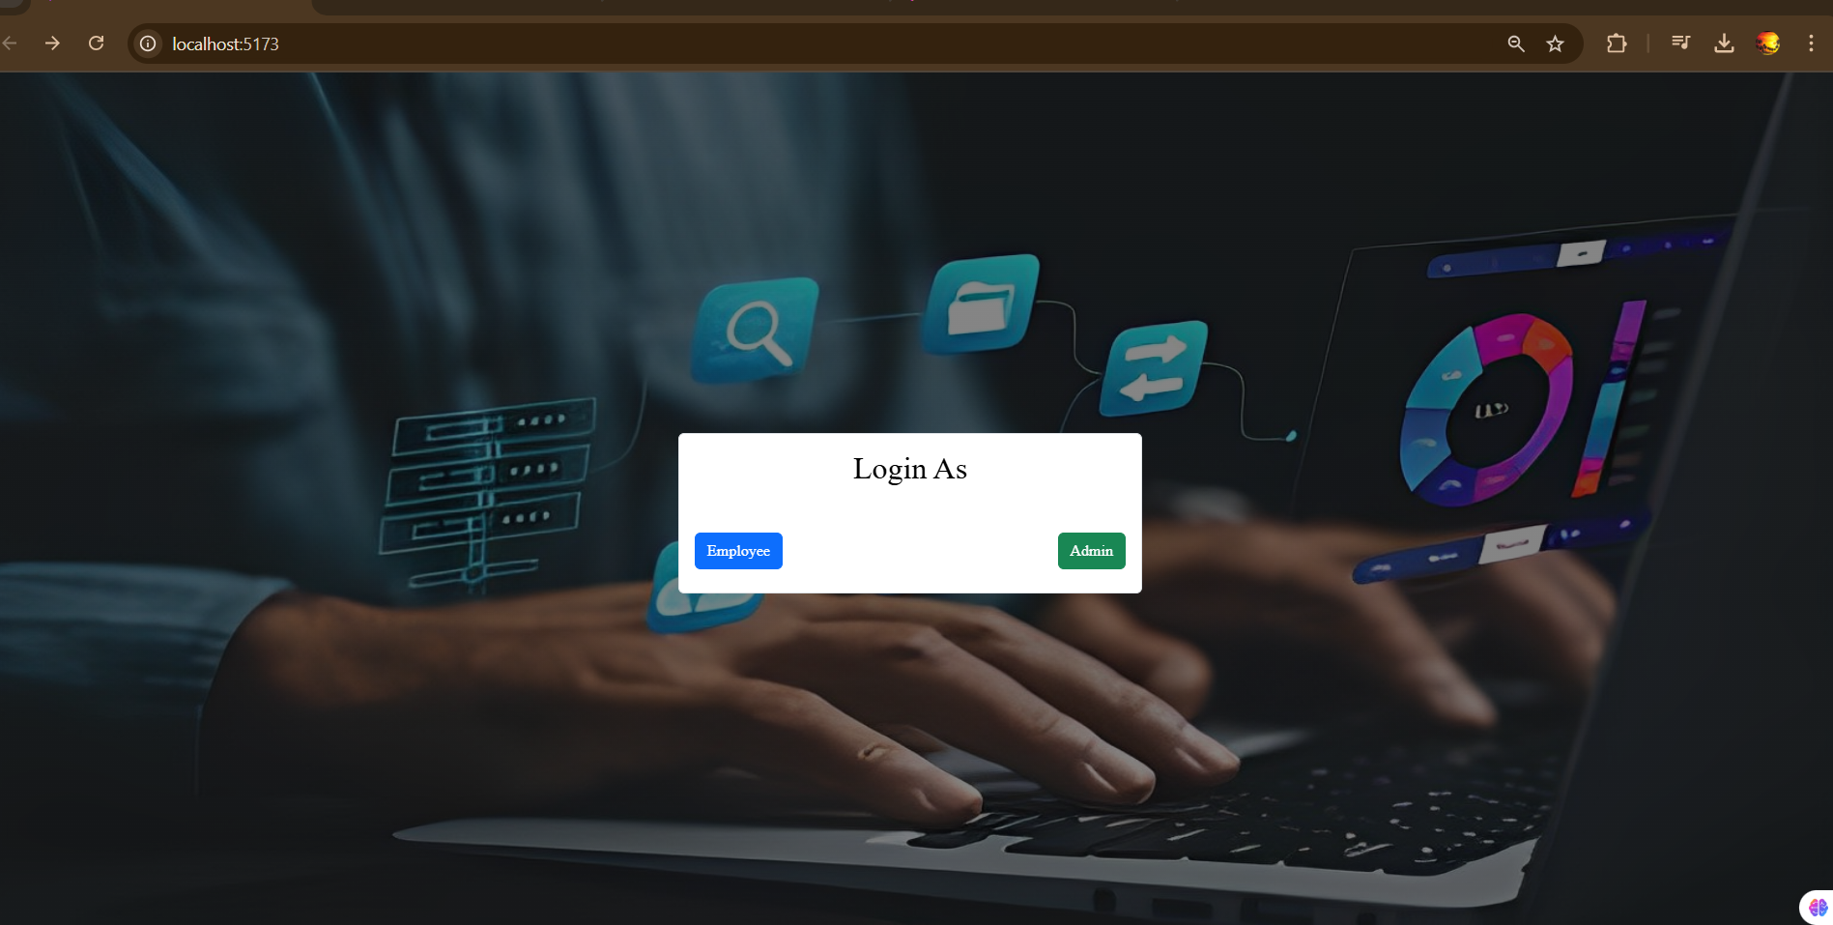


Frontend Development: User Interface and User Experience
1. React-Based Dynamic UI
Built using React.js for a modular, fast, and responsive interface.
React Router DOM for smooth, single-page application navigation.
2. Bootstrap & Icons for Modern Design
Bootstrap 5 ensures a responsive, mobile-friendly UI.
Bootstrap Icons enhance the visual appeal and usability of the system.
3. API Integration with Axios
Axios enables fast and efficient communication with the backend.
Ensures real-time updates for employee records, attendance, and payroll.
4. User-Centric Experience (UX) Improvements
Clean layout with easy-to-navigate dashboards for Admin, HR, and Employees.Interactive
UI components with alerts, modals, and tooltips for better engagement.
5. Role-Based Interface Customization
Different UI views for Admin, HR, and Employees based on role permissions.
Secure login/logout authentication using JWT for a seamless user experience.

Slide 7
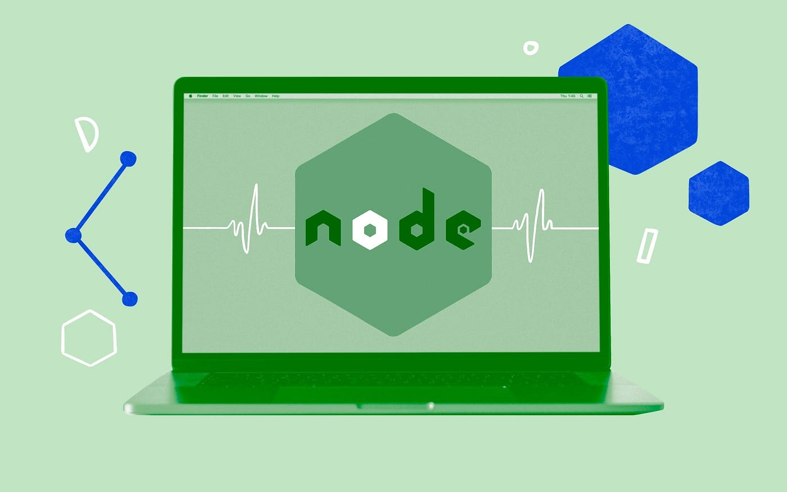
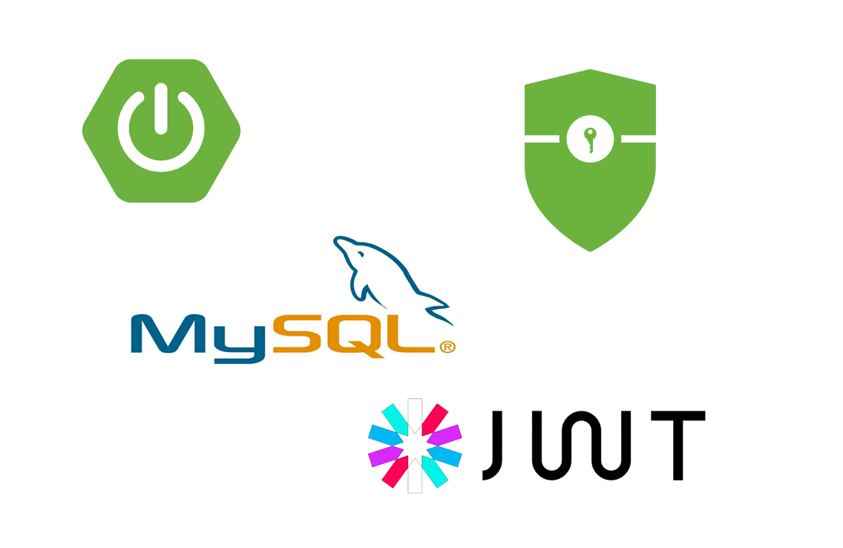
Back-End Development: API Design and Implementation
Express.js for RESTful API Development
Express.js used to build scalable and efficient backend services.
Follows RESTful API principles for structured and easy-to-maintain endpoints.
1
Authentication & Security with JWT
jsonwebtoken (JWT) used for secure authentication and session management.
Role-based access control for Admin, HR, and Employees.
2
Database Integration with MySQL
MySQL2 library used for database connectivity and queries.
Implements CRUD operations for managing employees, attendance, and payroll.
3
Middleware & File Handling
Multer for handling employee file uploads (documents, profile images).
Cors & Cookie-Parser to enable cross-origin requests and secure cookies.
4
Optimized API Routing & Performance
Modular API routes for different functionalities (employees, attendance, payroll).
Nodemon for automatic server restarts during development for efficiency.
5

Slide 8



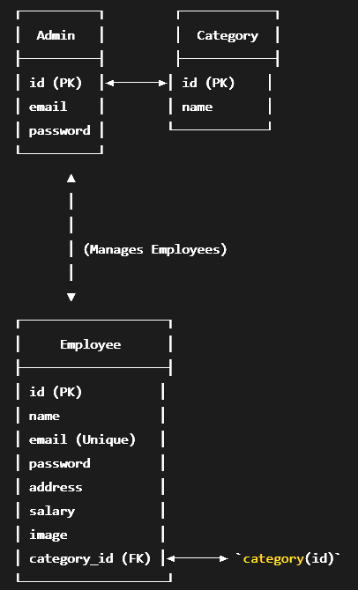

Database Design: Schema and Data Management
1. Relational Database (MySQL) for Structured Data
MySQL2 used for efficient database management and queries.
Ensures data integrity and consistency with structured tables and relationships.
3. Indexes & Constraints
Admin Table
id is the Primary Key.
email is a Unique Key.
Category Table
id is the Primary Key.
Employee Table
id is the Primary Key.
email is a Unique Key.
category_id is a Foreign Key that references category(id), with ON DELETE SET NULL
1
2. Schema Design & Table Structure
3
4. Optimized Query Performance
Indexed columns for faster search operations.
Joins & stored procedures used for complex queries like salary calculations.
Data Security & Backup Management
Hashed passwords using bcrypt for authentication security.
Regular backups & data recovery mechanisms for preventing data loss.
2
4

Slide 9
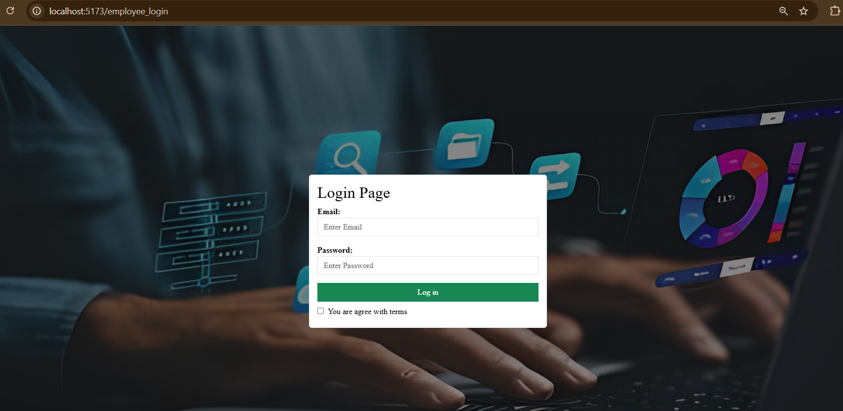
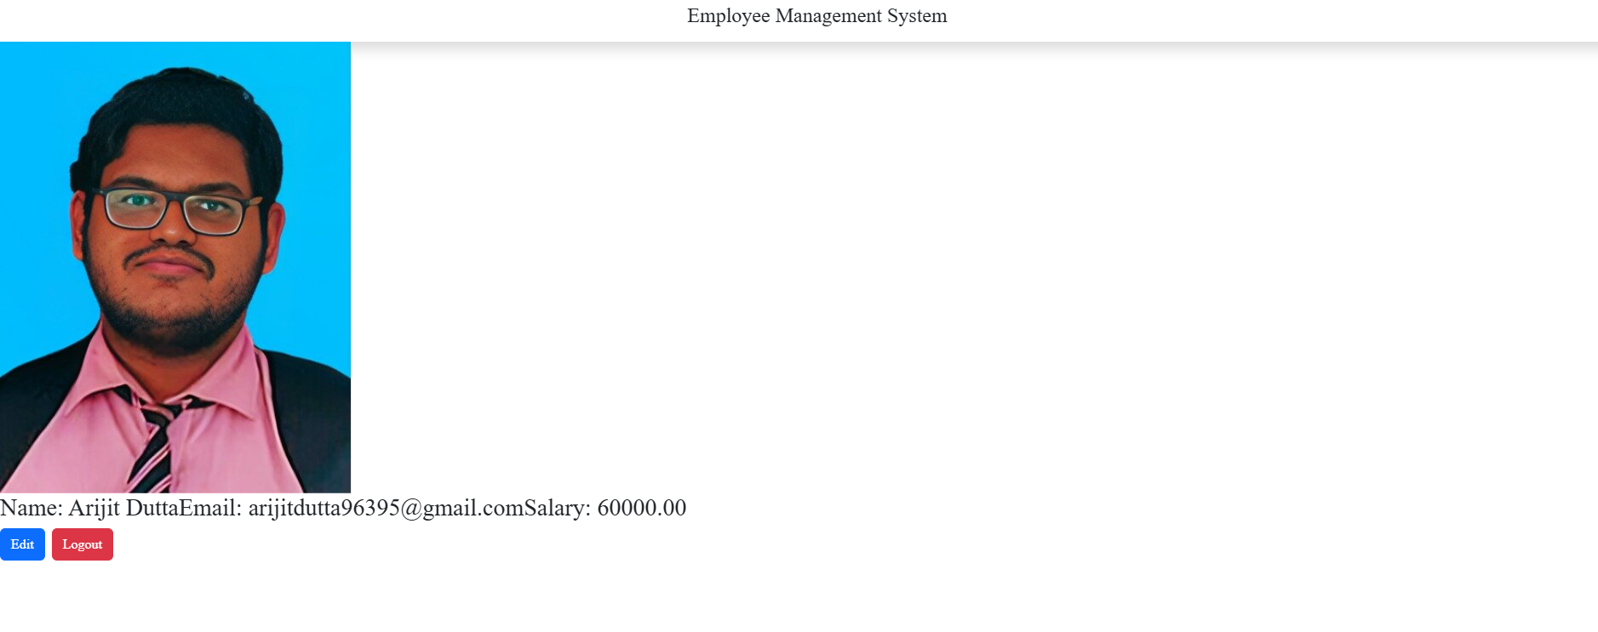
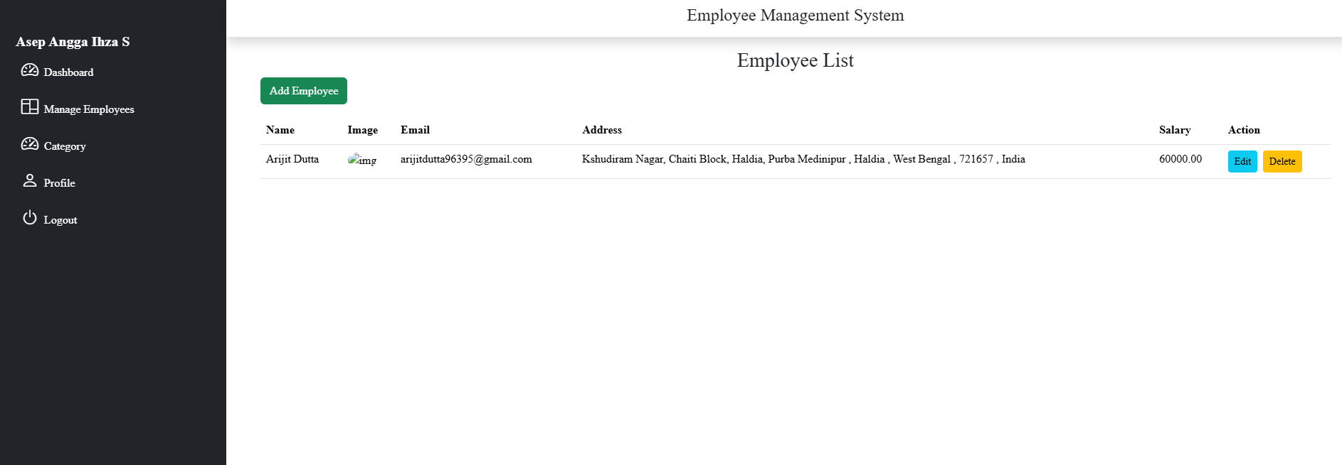
Web Dashboard

Slide 10
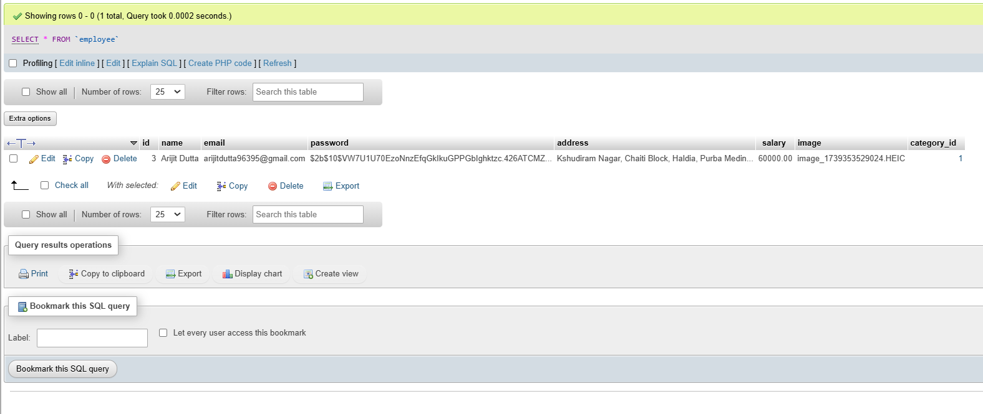
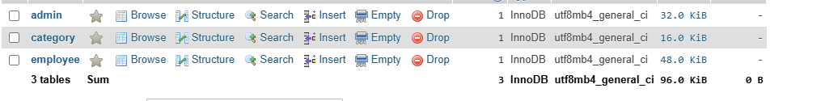
Mysql Database

Slide 11

Future Scope and Enhancements
AI-Powered Performance Analysis
Implement AI-driven insights to evaluate employee performance trends and productivity.
Biometric Attendance Integration
Link fingerprint or facial recognition for secure and accurate employee attendance tracking.
Mobile App Development
Develop a React Native or Flutter-based mobile app for on-the-go employee management.
Payroll Automation & Tax Compliance
Integrate automated payroll processing with tax calculation and legal compliance for different regions.

Slide 12
Acknowledgements and Conclusion
The Employee Management System is a full-stack web application designed to streamline employee records, attendance tracking, payroll management, and overall HR operations. By integrating React.js, Express.js, MySQL, and JWT authentication, we have built a secure and efficient system that enhances workforce management. Through the challenges faced and solutions implemented, we have gained hands-on experience in handling real-world software development complexities.
We would like to express our sincere gratitude to our mentors, professors, and guides for their invaluable support and guidance throughout the development of this Employee Management System. Their expertise and insights have played a crucial role in shaping this project. We also extend our appreciation to our peers and colleagues for their constructive feedback and collaboration, which have greatly contributed to refining the system. Additionally, we acknowledge the open-source community and various online resources that have helped us implement the latest technologies effectively.

